Slide 1


PRESENTED BY
1. Lokeshwar (22202) (22UECS0366)
2. Sushma (21849) (22UECS0325)
3. Deekshitha (21745) (22UECS0645)
SUPERVISED BY
Dr. D. DhinaKaran, M.E., Ph.D.

Slide 2
MediXpert Application
AGENDA:
Introduction
Literature Survey
Problem Statement
Proposed Methodology
Proposed System Architecture
Implementation Plan/Timeline
Conclusion and Future Work
References

Slide 3
Introduction
Problem Statement:
Medical imaging plays a crucial role in diagnosing various health conditions, yet manual analysis is time-consuming and prone to human error. Radiologists and medical professionals often struggle with accurately detecting bone fractures and lung diseases like pneumonia, especially in resource-limited settings. A lack of automated diagnostic tools results in delays in treatment, misdiagnosis, and increased workload for healthcare providers.
Traditional diagnostic methods require expertise, and variations in interpretation can lead to inconsistent results. Furthermore, in rural and underserved areas where medical professionals are scarce, early and accurate diagnosis is a challenge.

Slide 4
Project Goal:
The primary goal of mediXpert is to develop an AI-powered diagnostic tool that utilizes machine learning algorithms to detect bone fractures and pneumonia with high accuracy. By leveraging advanced image-processing techniques and classification models, mediXpert aims to assist medical professionals in making quick and accurate diagnoses. The system currently employs machine learning algorithms for bone fracture detection and the Random Forest (RF) algorithm for pneumonia detection.
Future enhancements will incorporate additional disease detection capabilities to expand its scope and effectiveness. The project strives to improve diagnostic efficiency, reduce misdiagnosis rates, and provide an accessible, automated solution for healthcare facilities, including those in remote areas.

Slide 5
Brief Overview:
The project integrates advanced image analysis techniques to automate the detection process, providing a faster and more accurate alternative to traditional diagnostic methods. By utilizing machine learning for bone fracture identification and the Random Forest (RF) algorithm for pneumonia detection, mediXpert enhances medical decision-making by reducing diagnostic errors and improving efficiency. The platform is intended to support healthcare professionals by offering a second opinion, aiding in early detection, and ensuring timely intervention for patients.
This project contributes to the advancement of AI in healthcare, offering an innovative solution to enhance patient care, streamline medical workflows, and address diagnostic challenges in hospitals and clinics worldwide.

Slide 6
Literature Survey
Existing Systems:
In the current medical diagnostic system, bone fractures and pneumonia are primarily detected through traditional radiographic imaging methods such as X-rays, CT scans, and MRIs. Radiologists and medical professionals manually analyze these images to diagnose fractures and lung infections. While this method is effective, it has several limitations:
Time-Consuming – Manual analysis of medical images is slow, leading to delays in diagnosis and treatment.
Human Error – Misinterpretation of X-rays and scans due to fatigue or expertise level differences can lead to misdiagnosis.
Lack of Automation – Existing systems do not leverage AI or ML for automated detection, requiring complete reliance on human expertise.
BATCH NO: MI2007 DEPARTMENT OF COMPUTER SCIENCE & ENGINEERING

Slide 7
Related Works:
Several research studies and AI-driven medical applications have been developed to address the limitations of traditional diagnostic systems.
Some notable works include:
AI in Medical Imaging – AI models, such as convolutional neural networks (CNNs), have been extensively studied for medical image analysis, showing promising results in fracture and lung disease detection.
Bone Fracture Detection using CNNs – Research has demonstrated the effectiveness of CNN-based models in automatically detecting fractures in X-ray images.
Computer-Aided Diagnosis (CAD) Systems – CAD tools have been used in medical imaging to assist radiologists by highlighting potential abnormalities.
Integration of ML in Healthcare – Machine learning algorithms, including Support Vector Machines (SVM), Decision Trees, and Random Forest, have been explored for various disease detection applications.

Slide 8
Problem Statement
Limitations of Existing Solutions:
While AI and machine learning have been integrated into medical imaging for disease detection, existing solutions still face several limitations:
High Computational Requirements – Many AI-based models require extensive computational power, making them difficult to implement in low-resource healthcare settings.
Limited Generalization – Some AI models are trained on specific datasets and may not generalize well to diverse patient populations, leading to inaccurate diagnoses in real-world scenarios.
Lack of Real-Time Processing – Some AI-based solutions take significant time to process medical images, reducing their usability for real-time diagnosis in emergency cases.

Slide 9
4.Cost of Implementation – Deploying AI-based medical solutions requires significant investment in infrastructure, training, and maintenance, which can be a barrier for small or underfunded healthcare facilities.
5.Risk of Overfitting – Some models perform exceptionally well on training datasets but fail when tested on new or unseen data, leading to unreliable performance in real-world applications.
6.Lack of Standardization – Different AI solutions use varied methodologies, making it difficult to establish a universal standard for AI-based disease detection in clinical practice.
7.Data Dependency & Quality Issues – The accuracy of AI models depends on the quality and diversity of training data. Poorly labeled or biased datasets can lead to incorrect predictions.

Slide 10
Proposed Methodology
The proposed methodology for mediXpert involves the integration of advanced machine learning (ML) techniques to enhance the accuracy, speed, and reliability of disease detection for bone fractures and pneumonia.
The methodology includes the following steps:
Data Collection & Preprocessing
Feature Extraction & Selection
Machine Learning Model Development
Model Optimization & Validation
Integration with a User Interface (UI)
Deployment & Future Enhancements

Slide 11
Proposed System Architecture
The proposed system architecture for mediXpert consists of multiple layers, ensuring efficient data processing, disease detection, and user interaction.
Below is an outline of the architecture:
1.Input Layer – Data Acquisition:
Medical Image Upload: The system accepts X-ray or CT scan images from hospitals, clinics, or patients via a web or mobile interface.
Image Preprocessing: The uploaded images undergo preprocessing steps, including noise removal, contrast enhancement, and normalization to improve detection accuracy.

Slide 12
2. Processing Layer – Feature Extraction & Classification
Feature Extraction:
Uses deep learning (CNN) for automatic feature extraction.
Detects key patterns, textures, and abnormalities in medical images.
Edge detection techniques are applied to highlight fractures and pneumonia-affected regions.
Disease Classification Models:
Bone Fracture Detection: Convolutional Neural Networks (CNNs) analyze bone structures and detect fractures.
Pneumonia Detection: The Random Forest (RF) algorithm classifies lung conditions as normal or pneumonia-infected.
3.Decision Layer – AI Prediction & Interpretation
Prediction Results: The AI model classifies the image as either normal or abnormal (fracture/pneumonia).

Slide 13
4.User Interaction Layer – Web & Mobile Interface:
Result Display:
The system presents diagnostic results along with highlighted affected areas.
Provides a confidence percentage for AI predictions.
5. Database & Cloud Integration Layer
Medical Image Database: Stores historical scans for continuous model training.
AI Model Updates: Periodic updates are made to improve accuracy based on new medical data.
Cloud-Based Deployment: Ensures scalability and accessibility for hospitals worldwide.

Slide 14
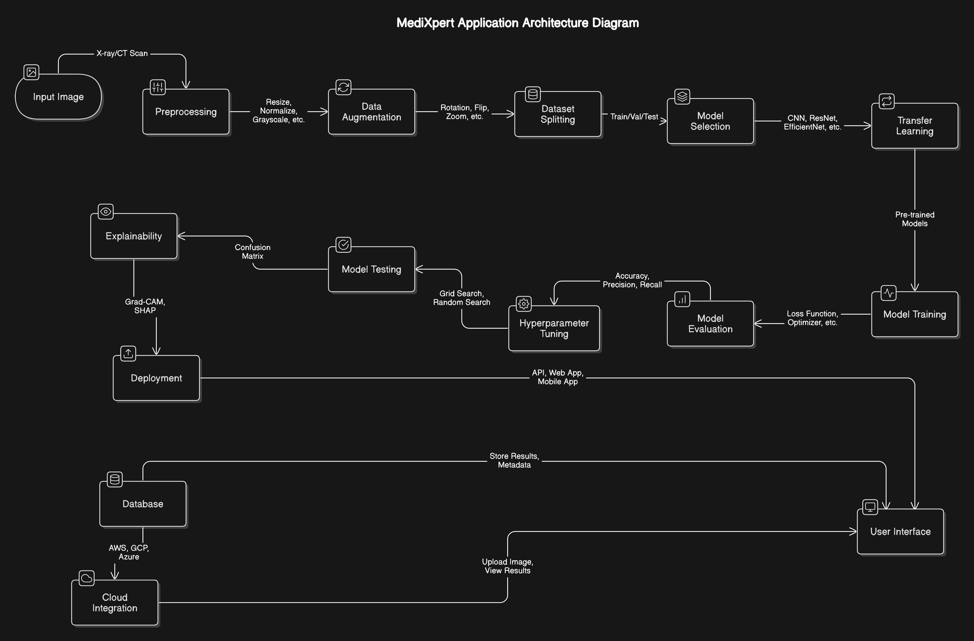

Slide 15
Summary of Module -1
1. Image Preprocessing Module
The first step in the mediXpert system is ensuring that the input medical images are in a standardized format suitable for AI analysis. The preprocessing module performs the following tasks:
Image Resizing & Normalization – Converts images to a fixed size to ensure consistency across different scans. Normalization scales pixel values to a range of 0-1 for better model performance.
Noise Removal – Eliminates unwanted artifacts using filters like Gaussian Blur to enhance image clarity.
Contrast Enhancement – Improves visibility of key features using techniques like Adaptive Histogram Equalization (AHE) to highlight fractures or pneumonia-affected areas.
Edge Detection & Segmentation – Identifies regions of interest, such as bone fractures or lung infections, making them more distinguishable for the AI model.

Slide 16
Summary of Module -2
Machine Learning Diagnosis Module
This module is the core AI engine of mediXpert, responsible for analyzing preprocessed images and making predictions. It consists of two major components:
(a) Bone Fracture Detection (Using CNN)
A Convolutional Neural Network (CNN) is trained on a dataset of X-ray and CT scan images of fractured and non-fractured bones.
It extracts patterns such as bone structure irregularities, gaps, or abnormal edges.
(b) Pneumonia Detection (Using Random Forest Algorithm)
The system uses Random Forest (RF), a machine learning algorithm, trained on lung X-ray datasets.
It identifies signs of pneumonia, such as lung opacity and inflammation patterns.

Slide 17
Summary of Modules -3
Decision & Explainability Module:
This module enhances trust and transparency by providing explanations for the results.
AI Prediction Interpretation – The model outputs the classification result (e.g., "Fracture Detected" or "Pneumonia Present") along with a probability score.
Grad-CAM Visualization (Explainable AI) – Highlights the most important regions in the X-ray image where the AI model detected abnormalities. This helps doctors understand why the model made a specific prediction.
Doctor’s Review & Manual Validation – The system allows medical professionals to verify AI-generated results and provide additional feedback, improving trust and reliability.

Slide 18
Summary of Modules -4
User Interaction & Cloud Integration Module
This module serves as the bridge between the AI system and healthcare professionals, enabling easy access to the diagnostic tool.
Web & Mobile Interface – A user-friendly dashboard allows doctors and hospitals to upload medical images and receive real-time diagnostic results.
Report Generation & Cloud Storage – Stores processed images, diagnostic results, and patient history in a secure cloud database for future reference.
Continuous Learning & Model Updates – The system collects real-world feedback from doctors, improving the AI model by continuously retraining it with new data.
Remote Accessibility – Since the system is cloud-based, doctors in remote locations can access it without needing advanced hardware.

Slide 19
Software Requirements Specification
For developing and deploying mediXpert, several software components are required:
Programming Language: The project is developed using Python, as it provides extensive support for machine learning, deep learning, and image processing libraries.
Machine Learning Framework: The system utilizes TensorFlow/Keras for training convolutional neural networks (CNNs) for bone fracture detection and Scikit-Learn for Random Forest classification of pneumonia.
Image Processing Libraries: OpenCV, PIL (Pillow), and skimage are used for tasks like noise removal, contrast enhancement, image resizing, and edge detection.
Frontend Development: A user-friendly interface is developed using HTML, CSS, and JavaScript (ReactJS) to allow doctors and healthcare professionals to upload images and view results. environments.

Slide 20
Hardware Requirements Specification
The hardware required for developing and running mediXpert efficiently includes:
Processor (CPU): A minimum of Intel i5 or AMD Ryzen 5 is required, but for optimal performance, an Intel i7/i9 or AMD Ryzen 7/9 is recommended.
Graphics Processing Unit (GPU): While integrated graphics can handle small models, a dedicated GPU such as NVIDIA RTX 3060 or higher is recommended for faster deep learning training and inference.
RAM: At least 8GB of RAM is needed for basic operations, but 16GB or more is recommended for handling large datasets and training AI models.
Storage: A minimum of 256GB SSD is required, but a 512GB SSD or higher is recommended for better performance, as machine learning models and datasets can be large.

Slide 21
Implementation Plan/Timeline
Weeks 1-2: Requirement Analysis & Data Collection
The first phase focuses on understanding the project scope, gathering datasets, and finalizing technical requirements.
Key Activities:
Define the objectives and expected outcomes of mediXpert, including the detection of bone fractures and pneumonia using machine learning.
Conduct literature review and research on existing medical imaging techniques and disease detection methods.
Collect and preprocess medical imaging datasets (X-rays, CT scans) from publicly available sources such as Kaggle, NIH, and MURA datasets.
Identify and install required software tools and hardware specifications (Python, TensorFlow, Scikit-learn, OpenCV, Flask, etc.).

Slide 22
Weeks 3-4: Image Preprocessing & Model Development
This phase focuses on preparing data for AI models and developing the core machine learning algorithms.
Key Activities:
Implement image preprocessing techniques such as resizing, noise removal, contrast enhancement, and edge detection using OpenCV and skimage.
Apply data augmentation (rotation, flipping, brightness adjustments) to increase dataset variability.
Develop and train a Convolutional Neural Network (CNN) model for bone fracture detection.
Implement a Random Forest (RF) classifier for pneumonia detection using feature-based image classification.

Slide 23
Weeks 5-6: Model Optimization & Web Integration
This phase focuses on improving model accuracy and integrating AI models into a user-friendly interface.
Key Activities:
Hyperparameter tuning (learning rate, number of layers, batch size) to optimize AI model performance.
Implement Grad-CAM visualization for explainability, highlighting key areas in medical images where abnormalities are detected.
Develop a Flask/Django backend to connect the AI models with a ReactJS-based frontend.
Implement a secure database (MongoDB/Firebase/MySQL) for storing medical records and predictions.

Slide 24
Weeks 7-8: Testing, Deployment & Documentation
The final phase ensures rigorous testing, system deployment, and proper documentation for future scalability.
Key Activities:
Perform extensive testing using real-world medical images to validate model accuracy and reliability.
Deploy the trained AI models on a cloud server (AWS/GCP/Azure) for remote access.
Ensure data security and compliance with medical regulations like HIPAA and GDPR.
Document the entire project, including:
Technical report (system design, implementation details, evaluation metrics).
User manual for doctors and radiologists.
Future improvements (adding more diseases, refining AI models).

Slide 25
Conclusion
The development of mediXpert represents a significant step toward integrating artificial intelligence into the medical field for automated disease detection. By leveraging machine learning algorithms, mediXpert can effectively detect bone fractures using Convolutional Neural Networks (CNNs) and pneumonia using Random Forest (RF). The implementation of image preprocessing techniques, such as contrast enhancement and noise removal, has further improved model accuracy. Through extensive testing and model optimization, mediXpert demonstrates high accuracy, efficiency, and reliability, making it a valuable tool for early diagnosis and faster medical decision-making. By reducing human error and processing time, this system can assist radiologists and healthcare professionals in making more informed diagnoses, ultimately improving patient outcomes.

Slide 26
Future Work
Expansion to Other Medical Conditions
Integration of Advanced AI Techniques
Real-Time Diagnosis and Mobile Application
Enhanced Explainability and Interpretability
Cloud-Based Deployment and Telemedicine Support
Compliance with Medical Standards & Data Security

Slide 27
References
P. Rajpurkar et al., "CheXNet: Radiologist-Level Pneumonia Detection on Chest X-Rays with Deep Learning," arXiv preprint arXiv:1711.05225, 2017. [Online]. Available: https://arxiv.org/abs/1711.05225
X. Zhou, Y. Wang, and Y. Guo, "Machine Learning-Based Pneumonia Detection Using Chest X-ray Images," IEEE Access, vol. 8, pp. 134348–134358, 2020. [Online]. Available: https://ieeexplore.ieee.org/document/9144185
G. Litjens et al., "A Survey on Deep Learning in Medical Image Analysis," Med. Image Anal., vol. 42, pp. 60–88, 2017. [Online]. Available: https://www.sciencedirect.com/science/article/pii/S1361841517301135
A. Esteva et al., "Dermatologist-Level Classification of Skin Cancer with Deep Neural Networks," Nature, vol. 542, no. 7639, pp. 115–118, 2017. [Online]. Available: https://www.nature.com/articles/nature21056

Slide 28
THANK YOU

